Slide 1
INFODIARY: CONTACT APP MANAGEMENT
Group Members :
1.Sakshi Balekar 20104103
2.Sarthak More 20104116
3.Prathamesh Lambate 20104064
Project guide
Prof. Rucha Kulkarni

Slide 2
Contents
Introduction
Objectives
Scope
Literature Survey
Proposed System
Project Outcomes
Block Diagram
Use Case/DFD
Technology Stack
Suggestions in Review-1
Result and Discussion
Conclusion and Future Scope
References
Notes:
2

Slide 3
1. Introduction
In today’s fast-paced business world, it is very hard to remember everyone’s name and their individual preferences.
That’s why it’s essential to store data electronically, share it with others when needed.
Here, we are creating a web-based application in which we are providing information about various services to the customers.
So, we have come up with a concept of INFODIARY.
Notes:
3

Slide 4
Purpose
The main purpose of this application is to provide local search related services to the users.
Details within the application includes information about doctors, travel agencies, schools, colleges and various opportunities.
It provides a simple, interactive, intuitive and extremely fast way of searching services.

Slide 5
2. Objectives
To keep a full record of all the available services.
To strengthen your marketing efforts.
To build long-lasting Customer Relationships.
To have a quick reach for Information.
To provide information to its users about various services at any point of time and at any place.
Notes:
5

Slide 6
3. Scope
Can provide an excellent customer experience and support services.
Can make communication between the users and the business.
Can also provide fast and reliable services to the users.
Notes:
6

Slide 7
4. Literature Survey
Smart Social Contact Management System for Better Memory Recall[1]
Shailesh U. Sambhe, Sachin Murab
International Journal of Engineering and Innovative Technology (IJEIT) Volume 3
Published on 9 March 2014
This paper presents an empirical study of an intelligent social contact management system — SCM. From the point of view of human memory, we attempt to design SCM to match the specific contact memorizing problem. Through an online survey, we identify four sets of contact-related information like working information, sex, last meeting time and location. Second, the decline of memory retention with time proves that people need more time to recall their earlier memory. Third, the memory bias in contact memorizing confirmed the self-reference effect in memory. As we continue to develop SCM, we hope to improve the contact retrieval method by using the priority ordering mechanism and developing an audio-based contact retrieval interface on smart phones.
Notes:
7

Slide 8
Gemma Bel- Enguix, M. Dolores Jimenez-Lopez
IEEE/WIC/ACM International Conferences on Web Intelligence and Intelligent Agent Technology[2]
Published on 10 October 2011
This paper presents an ability to leverage the power of a network of social contacts is important to get things done. However, as the number of contacts increases, people often find it difficult to maintain their contact network by using merely memory, and are frequently encompassed with questions. Existing contact tools make up for the shortage of unreliable human memory by storing contact information in the digital format. This paper supports the auto-collection of rich contact data by exploring various techniques.

Slide 9
5. Proposed System
Creating the registration and login activities.
Connecting the database and storing the registration details in the database.
The basic idea of our application is that multiple users can register on the application and access the same on login.
Creating placeholders for the name, email id, password, mobile number and date of birth for the user input in the registration activity.
We will be providing more secure functions that will be verified and authenticated.
Notes:
9

Slide 10
6. Outcome of Project
The main outcome of the project is the amount of exposure and knowledge that one can gain throughout the progression of the project.
A fair conclusion to design such applications is that it works on an innovative idea which gives you easy access to all details regarding your services.
Notes:
10

Slide 11
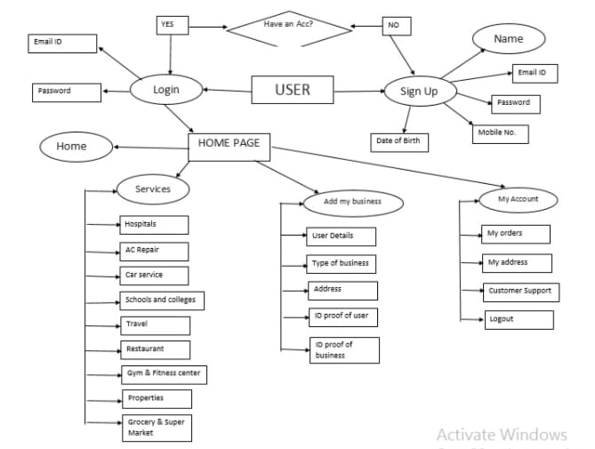
7. Block Diagram {FLOWCHART}
Notes:
11

Slide 12
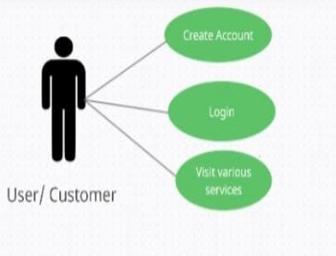
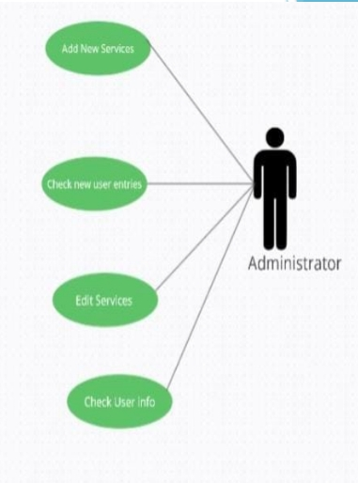
8. Use Case/Data Flow Diagram
Notes:
12

Slide 13
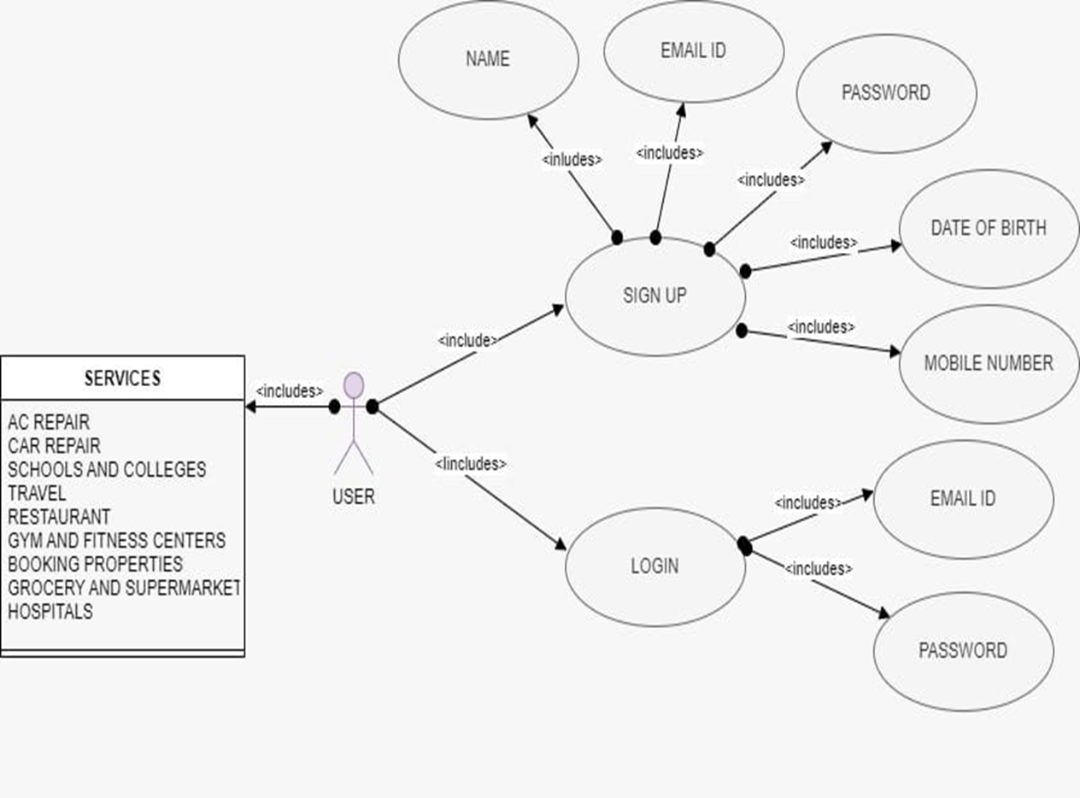

Slide 14
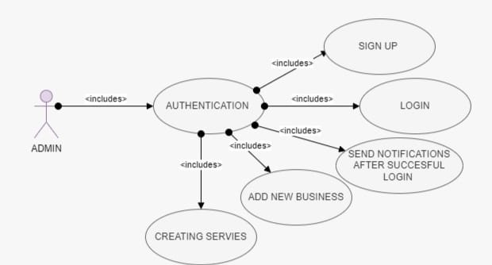
8. Use Case/Data Flow Diagram

Slide 15
9. Technology Stack
Programming language : HTML, CSS, JS
Operating system : Windows 11
Database : Firebase
Notes:
15

Slide 16
10. Suggestions in Review-I
A more deep research about the Literature survey.
Add other locations in the app other than Mumbai.

Slide 17

11. Result and Discussion
Restaurant Page

Slide 18
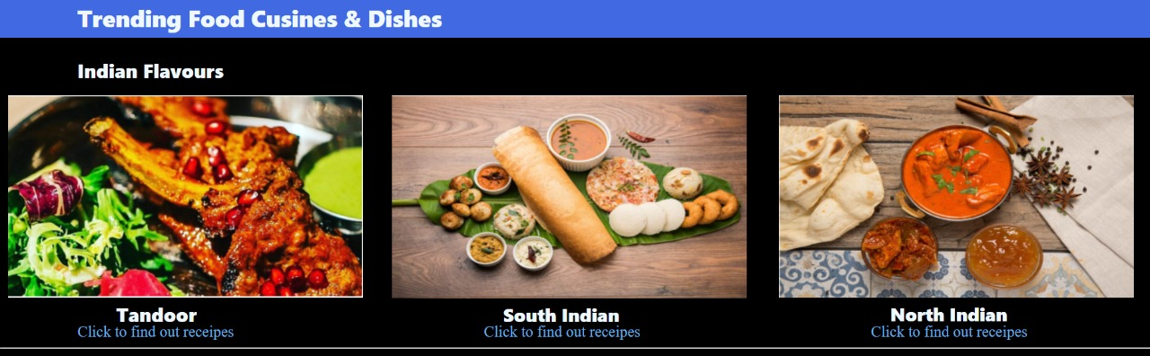
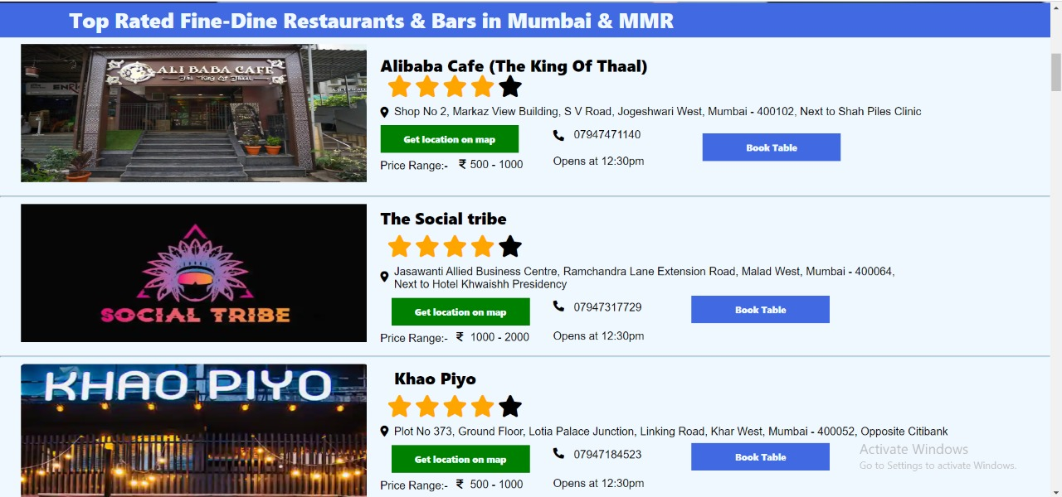

Slide 19
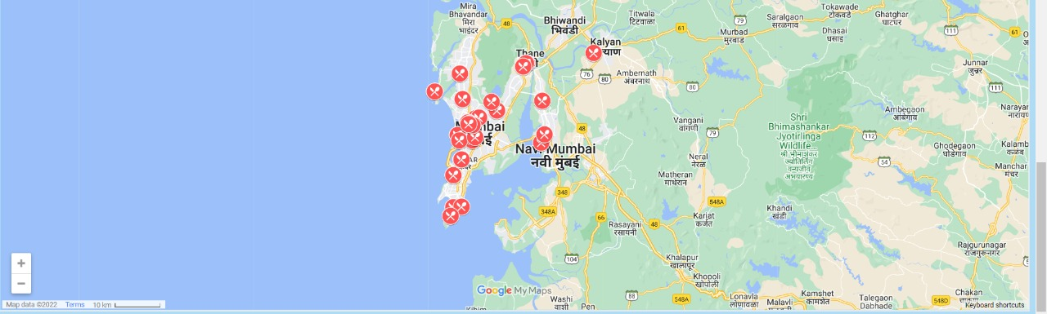
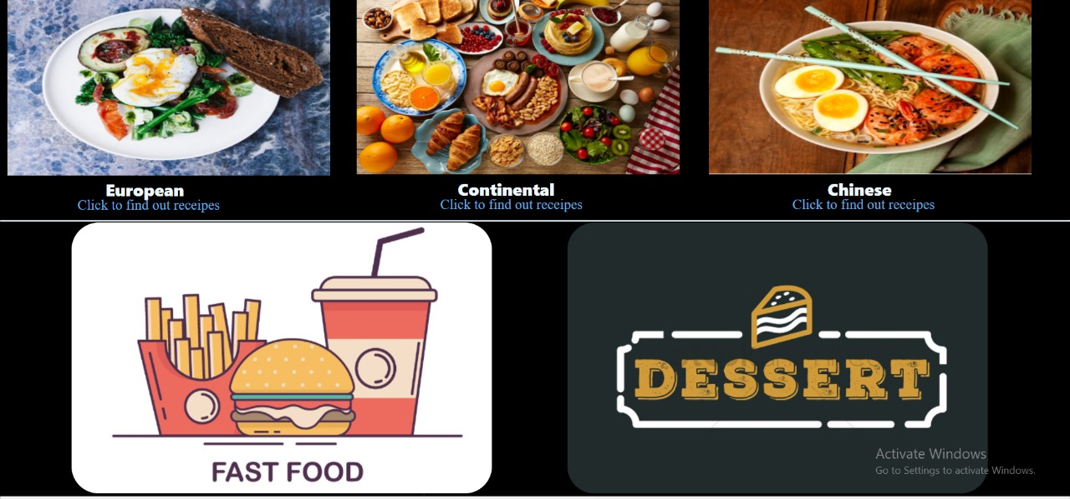

Slide 20
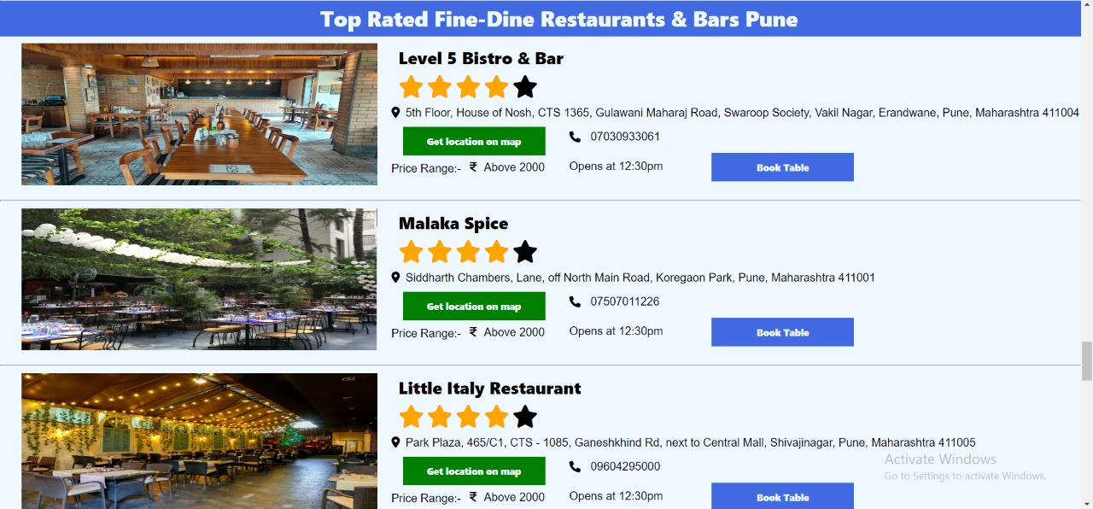
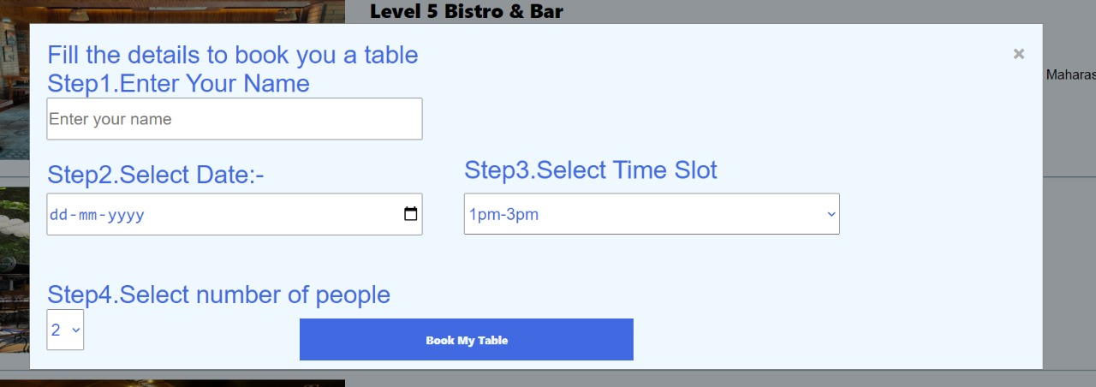

Slide 21
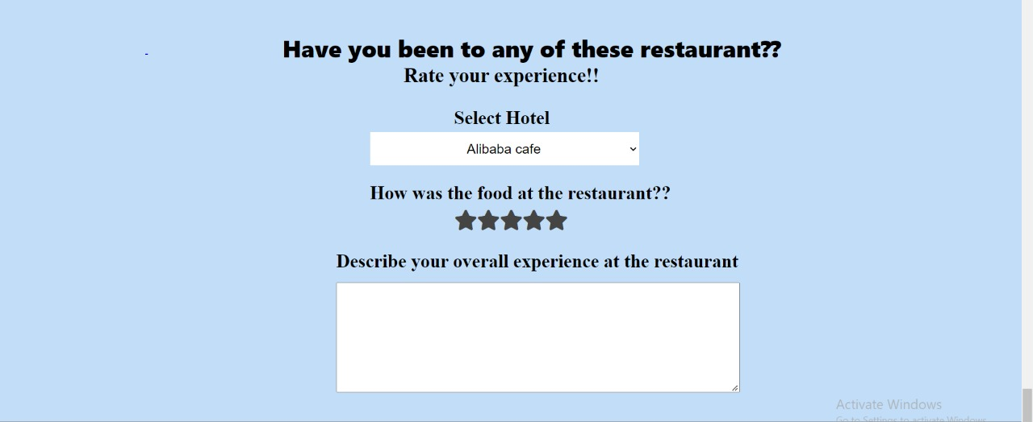
Restaurant Feedback Page

Slide 22
12. Conclusion and Future Scope
To conclude, INFODIARY works like a component which can access all the available facilities and performs various functions.
The project has a very vast scope in future.
It can be implemented in various fields in future.
It can also be updated in the future as and when requirement for the same arises, as it is very flexible.

Slide 23
13. References
[1]https://www.ijeit.com/Vol%203/Issue%209/IJEIT1412201403_42.pdf [2]https://ieeexplore.ieee.org/document/6040828/authors#authors
[3]https://www.slideteam.net/tag/contact-management-system-powerpoint-templates-ppt-slides-images-graphics-and-themes
[4]https://www.slideserve.com/inara/contact-management-system-powerpoint-ppt-presentation

Slide 24
Thank You...!!
Notes:
24

